Slide 1
QMS Awareness Presented by: PALM [Earlier: Process Team]

Slide 2
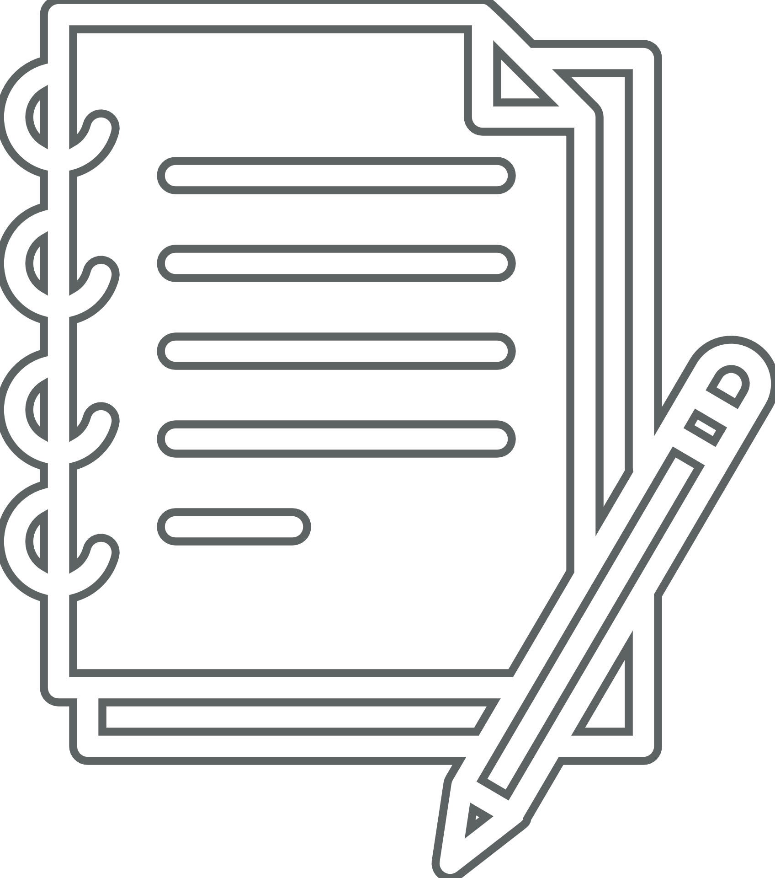
Agenda
Introduction to PALM
Introduction to Quality Management System
Quick Glance at Q@Core
Project Lifecycles
Overview of ALM-DevOps Practices & Integration
Processes for Developers & QA – A Quick Look
Q&A!
Notes:
Still WIP.. Will keep updating

Slide 3

Introduction to PALM
Productivity Assurance & Lifecycle Management (PALM), formerly known as Process Team
Aims to build the culture of Process Oriented & data driven implementation
Defines the right set of practices in the organization, with help of Practitioners
Emphasis on Tools driven practices rather than manual or documented way
Brings the flexibility required in context of project(s); enables adopting & integrating Customer specific processes
Interaction between PALM & Delivery team starts right at the project start.
Notes:
Still WIP.. Will keep updating

Slide 4
PALM – Functioning
New Customer Care [NCC]
Process Definition & Auditing Team
Process setup for New Customer projects
Conduct session on Best Practices and required tools
ALM tool setup and customization & consulting
Facilitates, Reviews and Suggests
Report results to Sr. Management
Stabilize Process & Tool usage in first 3-4 months
Transitions the Project to Auditing Team.
Process Definition & Maintenance
Impart Process & Tool Trainings
Provides Process and ALM tool consulting
Facilitate Implementation of ALM / Tool driven Practices
Conduct Audits on defined periodicity
Report Project health to Sr. Management & Executive Management
Involved in Process automation
Facilitate other Continuous Improvement Initiatives.

Slide 5
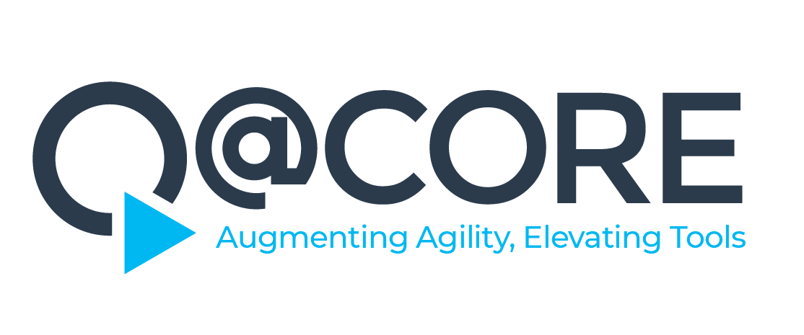
Quality Management System at Cybage
Notes:
Still WIP.. Will keep updating

Slide 6
Quick Glance at Q@Core
Apex Manual
Organization information
Organization & Project Structure
Lifecycles and Execution Models
Overview of Processes
Roles and responsibilities
Information of enabling functions
Process Manual
Traditional Development
Engineering
Project Management
Agile Development
Scrum
Kanban
Horizontal Processes
Support Services
Content Services
Business Processes
Departmental Manual
Human Resource
Administration
Information System
Notes:
Still WIP.. Will keep updating

Slide 7
Process Manual
Traditional Development Practices
Agile Development Practices
Engineering
Project Management
Agile Methodology
Scrum @ Cybage
Kanban @ Cybage
Project Initiation Process
Process for Scrum Projects
Process for Kanban Projects
Development Lifecycle
Project Initiation
Testing Lifecycle
Project Planning & Monitoring
Maintenance Lifecycle
Change Management
Project Closure

Slide 8
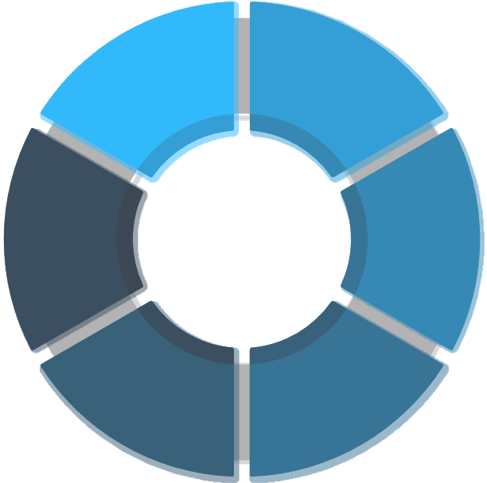







Process Manual
Horizontal Processes
Internal Audits
Configuration Management
Engineering
QMS Management
Knowledge Management
Root Cause Analysis
Continuous Improvement
Project Management
Resource Management
Decision Analysis & Resolution
Notes:
Let us now know each of the processes in detail… Let us start with SDLC..
Requirement Management and Development:
Ensures that both technical and non-technical requirements are captured, understood, documented and agreed upon with the customer.
In this process, template to document requirement understanding and ask queries to customer is defined i.e. Requirement Understanding Document, that’s RUD. A template to properly define requirements is also available, called as SRS.
One need not google to find how SRS should be prepared, what all should be the content in it. Just download it from Q@Core.
This process also includes sign-off of requirements with customer and baseline the requirements.
Now in agile world, things are managed as a part of Release Planning, Sprint Planning.
There are various tools to manage requirements, like Microsoft TFS, Atlassian Confluence, Rally etc.
Design:
This process ensures that software requirements are converted to technical design that forms the framework for coding and verifies proposed solutions based on requirements.
There are a few templates made available to ensure the proper design coverage like Architecture Design, Sub system level design, UI Design. If the person doing design is not using the provided templates, then she or he may miss the important pieces that should have been thought of while designing.
Construction Process:
This comprises of processes for coding and unit testing. What it says is – Understand the design, write unit test cases, set-up development environment, do coding, perform unit testing, get the code reviewed, debug the code and pass it on for compiling and build process.
From recent past, there have been tools used in the projects for Unit Testing and Code Review. SonarQube is mandated in Cybage for ensuring code quality.
Build and release Process:
This process is about building the unit tested code and doing sanity testing and sending it to QA.
There are 3 types of builds defined at Cybage –
Internal build – That is for QA team only
Client Release - That is to be released to client
Patch – Patch fixes for internal QA and/or for customer
This process expects Release Notes and Read Me should be available with build.
In the current world, Tools are used for build process like TFS, Jenkins, Bamboo, etc.
Testing Process:
Ensures comprehensive testing to check the product conformance with the requirements, before it is released to the customer using test plan, test cases and test reporting.
Deployment:
This is about deploying the product or application at production environment smoothly.
Any question here?
Am I okay with speed? Should I slow down or increase the pace ?

Slide 9

Lifecycle & Execution Methodologies

Slide 10
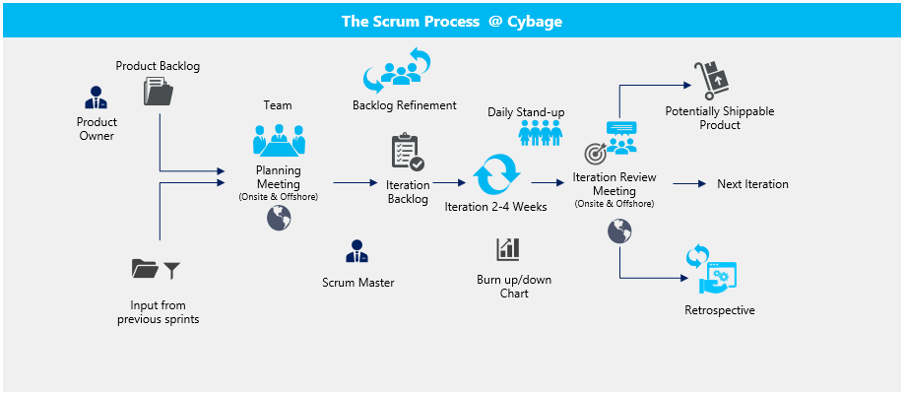
Scrum

Slide 11
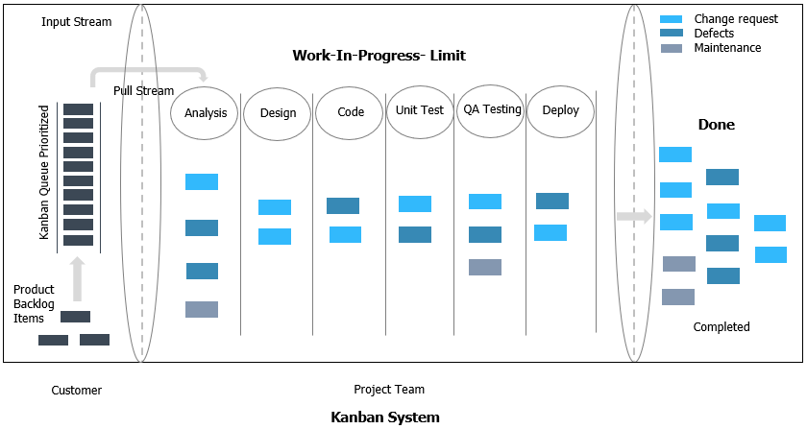
Kanban

Slide 12



Waterfall, Maintenance & Testing Lifecycle
Requirements
Build & Test
Unit Tests
Design
Maintenance Request
Impact Analysis
Implementation
Deploy
Development
Testing
Requirement Analysis
Test Planning
Test Case Design
Testing
Deployment
Test Closure
Regression Testing
Defect Retesting
Test Result Reporting
Maintenance

Slide 13
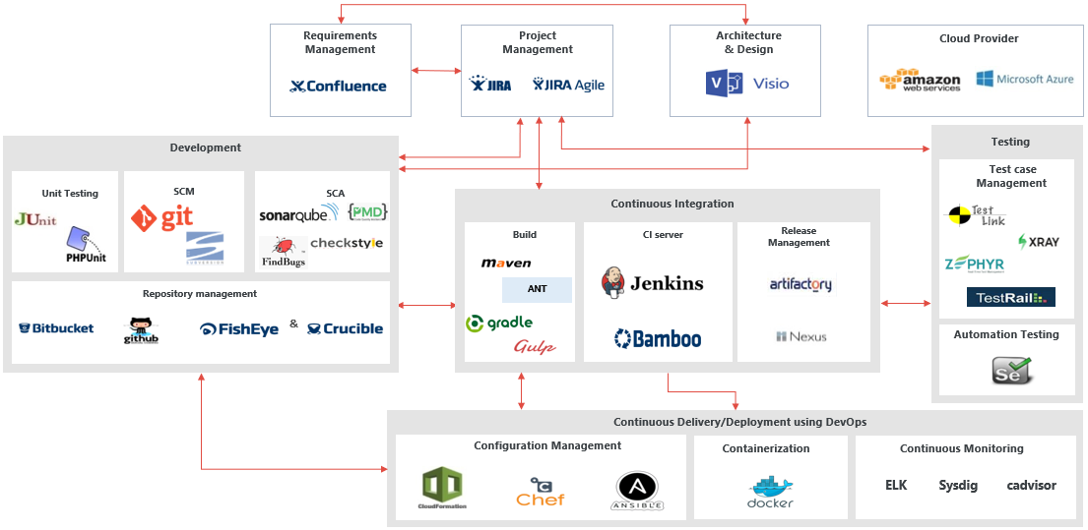
ALM-DevOps Practices & Tool Integration – Opensource & Licensed Tools

Slide 14
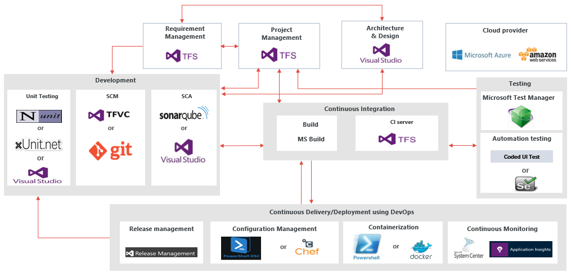
ALM-DevOps Practices & Tool Integration – Microsoft Tools

Slide 15
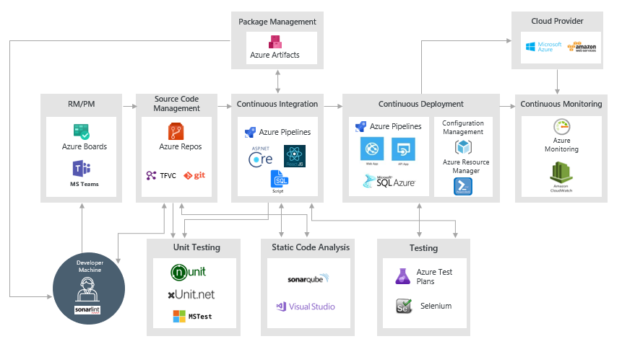
ALM-DevOps Practices & Tool Integration – Microsoft Azure

Slide 16
Set of Processes – QA’s Involvement
Traditional Development
Agile Development
Horizontal
Development Lifecycle
Testing Lifecycle Process
Performance Testing Process
Web Accessibility Test Process
Project Planning & Monitoring
Process for Scrum Projects
Process for Kanban Projects
Configuration Management
Root Cause Analysis
Resource Management
Knowledge Management
Continuous Improvement
Look forward for a detailed session to understand Role & Involvement…
Notes:
Still WIP.. Will keep updating

Slide 17
Set of Processes – Developer’s Involvement
Traditional Development
Agile Development
Horizontal
Development Lifecycle
Maintenance Lifecycle
Project Planning & Monitoring
Process for Scrum Projects
Process for Kanban Projects
Configuration Management
Root Cause Analysis
Resource Management
Knowledge Management
Continuous Improvement
Look forward for a detailed session to understand Role & Involvement…
Notes:
Still WIP.. Will keep updating

Slide 18


Thank You!
4/29/2021
www.cybage.com
Copyright © 2021 Cybage Software Pvt. Ltd. All Rights Reserved. Cybage Confidential.

